Slide 1
Housing Prices
Eyes to Analyze
(Derek H., Clemance K., Felipe L., Aderonke A.)

Slide 2

Introduction
The purpose of this analysis is to predict the potential sale price, in US Dollars, of 1,459 homes located in Ames, Iowa based on 79 categorical and numerical variables that describe different aspects of each house. The dataset, along with the approach for this analysis, derive from a Kaggle competition titled "House Prices - Advanced Regression Techniques".
We chose this competition due to our shared interests in finances and housing market.

Slide 3
Questions our Project Answered
What is the relationship between overall home quality to the sales price?
Do homes remodeled after 2005 have better conditions than those remodeled before 2005?

Slide 4
The Dataset
The Kaggle competition provided a "training dataset" that already includes a Sale Price for each home that will be used to train the machine learning model; said model will be used to make predictions on the observations contained in the "test dataset".
Based on the provided data, the team will perform an Exploratory Data Analysis and select the relevant variables in order to determine which machine learning model would result more accurate to predict the potential sale price of each home.

Slide 5
Data Steps
First, we imported the datasets.
To clean the data we removed the null values and transformed the categorical features to numerical form so our model would run.
Next, we created a new data set by listing the variables.
We shifted through the variables to find the variables with poor correlation to the Sales Price.
From there, we started the machine learning process.

Slide 6
Data Exploration
The analyzed dataset contained 79 variables plus the target variable.
43 of independent variables are numerical.
The remaining 36 variables are categorical.
The tools we used to analyze the dataset was:
Jupyter Notebook
Python

Slide 7
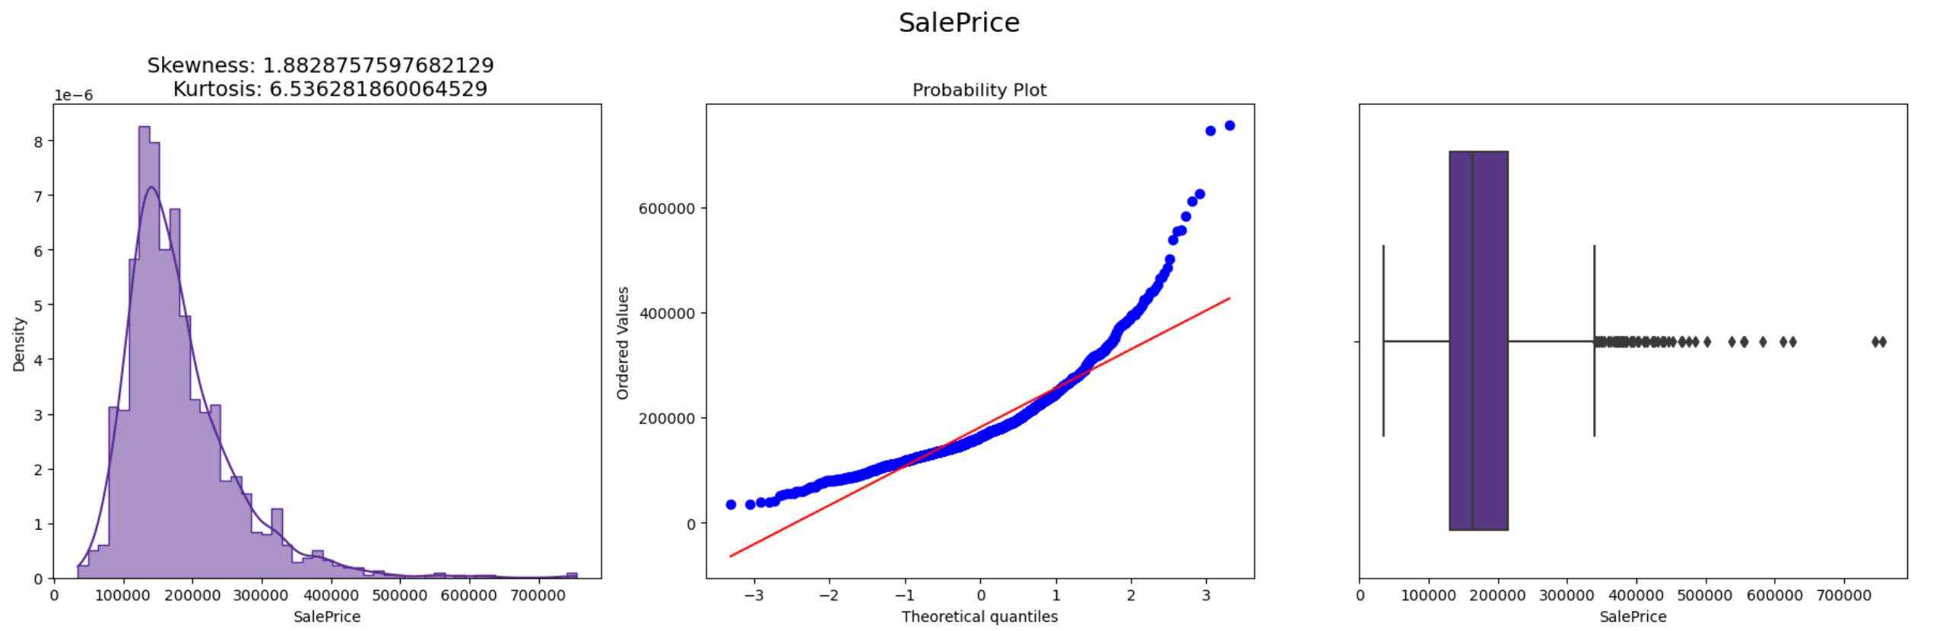
Data Exploration Target variable (Sale Price)
Distribution of target variable is positively skewed and observes kurtosis of 6.53, thus target variable is not normally distributed. The presence of outliers is noted as well.

Slide 8
Data Cleaning
This is a vital aspect of our project as this determined the success of our model. The process consisted of:
Substituting our null values with the median value of the numerical data using the imputer function.
Transforming our categorical data to numerical data using the Hot Encoder Function.

Slide 9
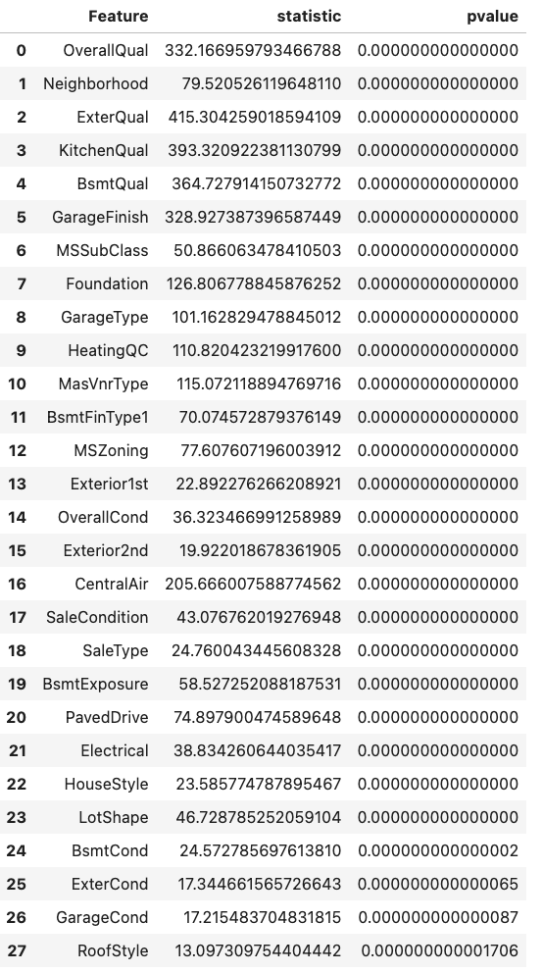
Data Exploration Categorical variables
An Analysis of Variance was performed to obtain those variables that would prove statistically significant for our analysis.

Slide 10
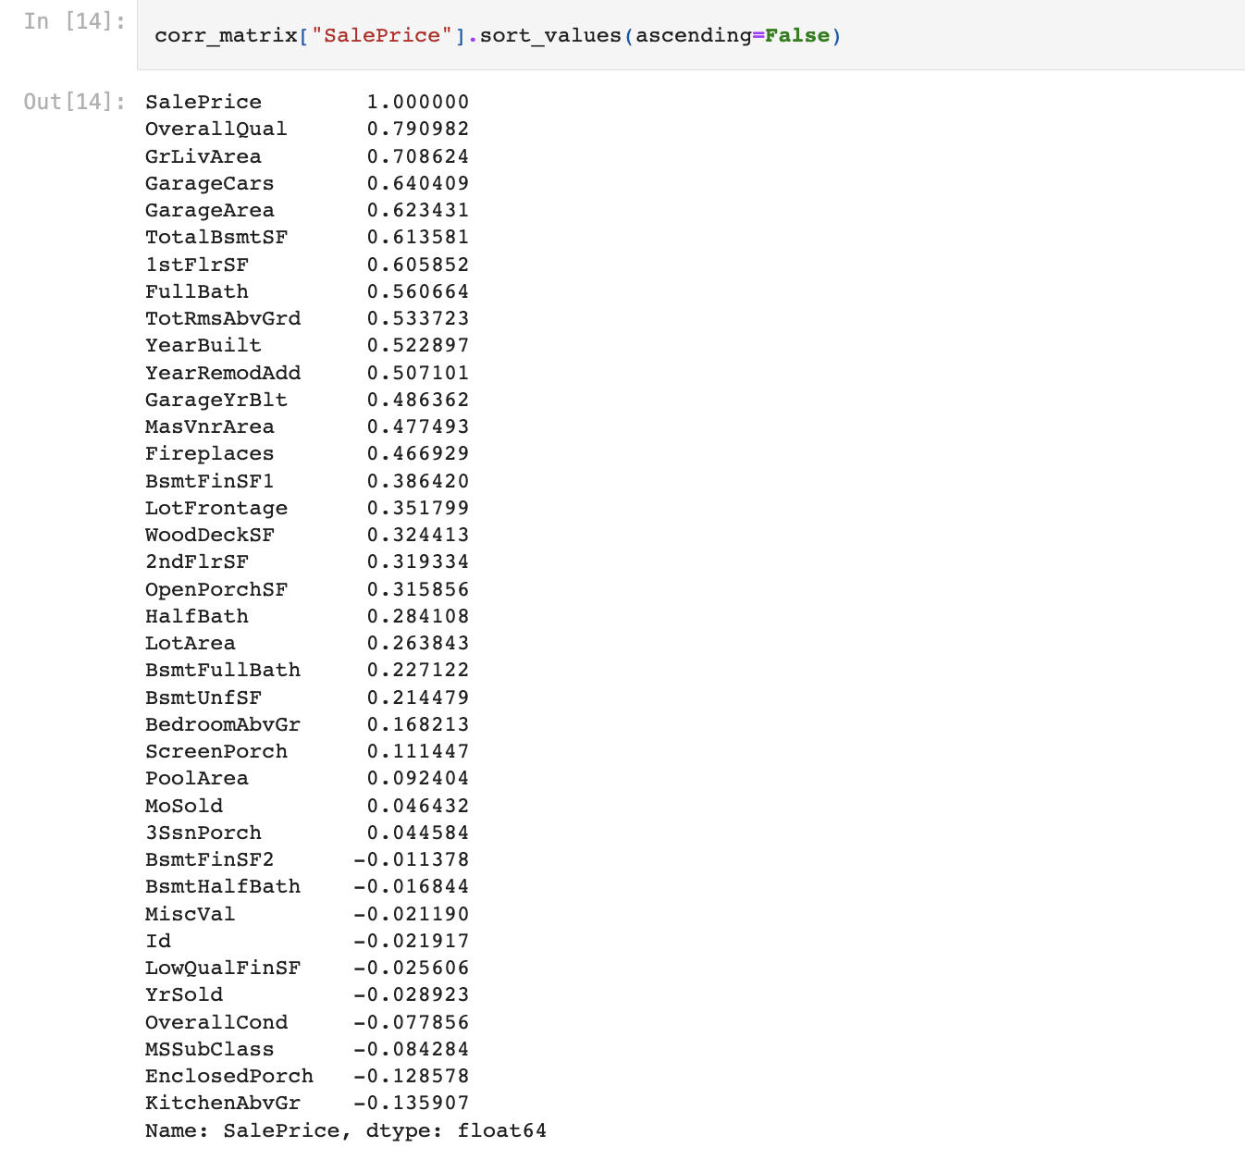
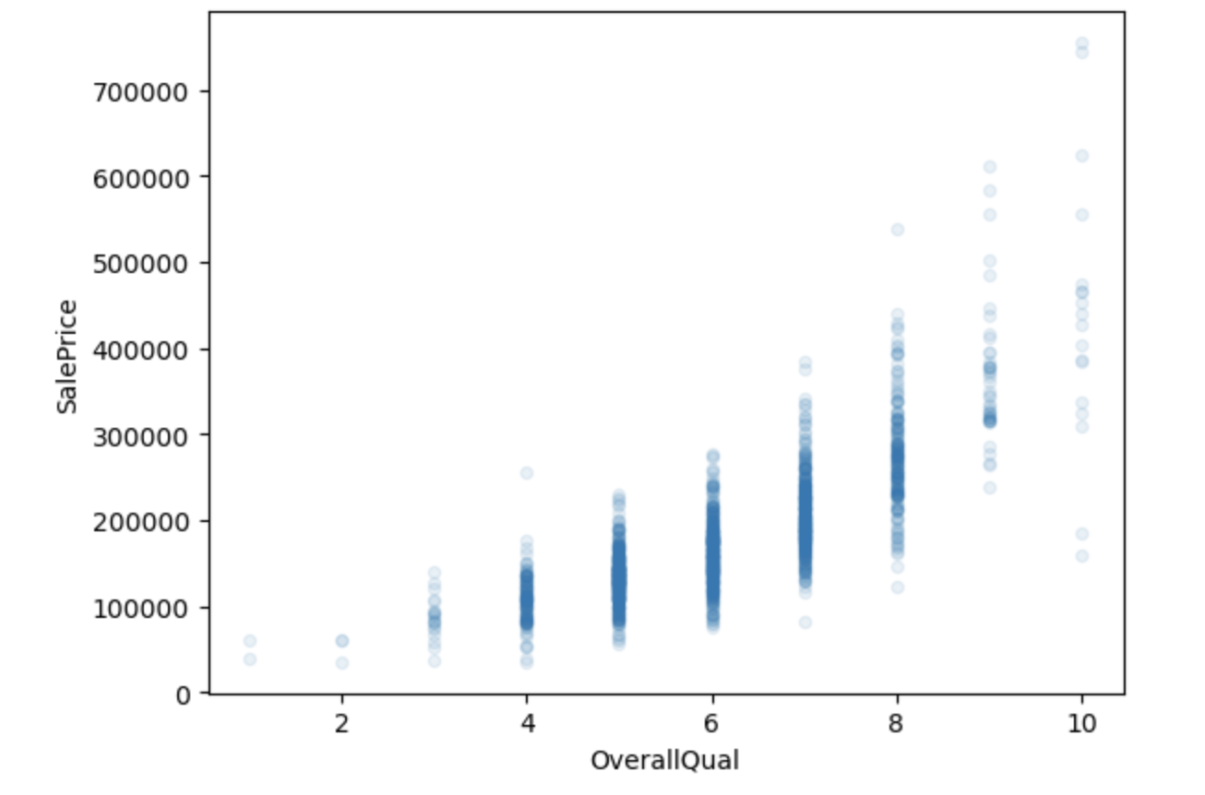
Sales Price vs Overall Quality

Slide 11
Sales Price vs Overall Quality

Slide 12
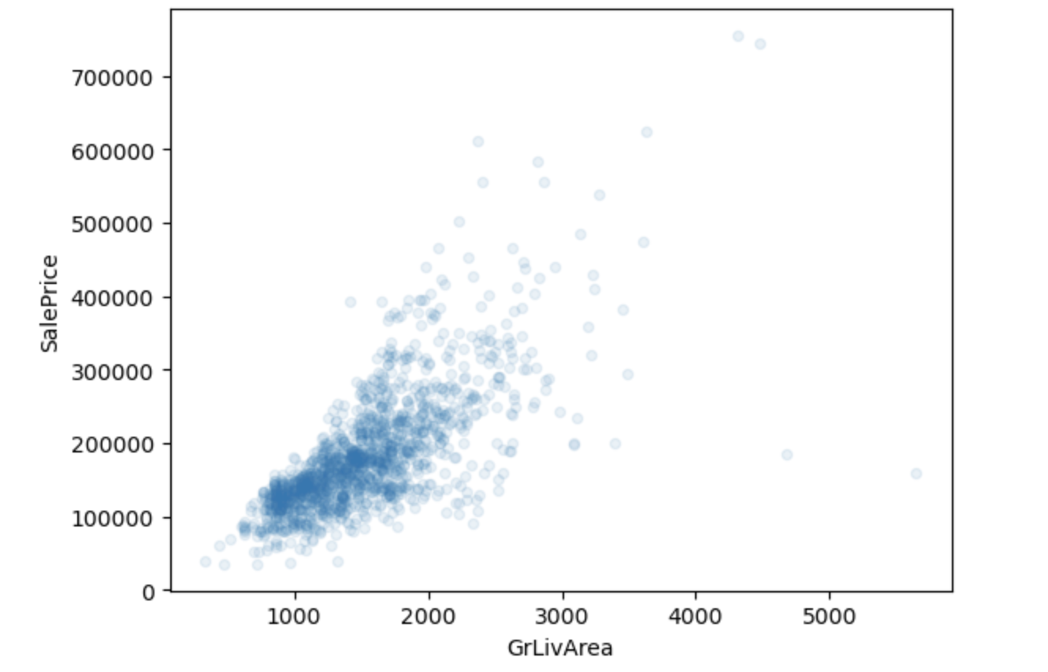
SalesPrice/Great Living Area

Slide 13
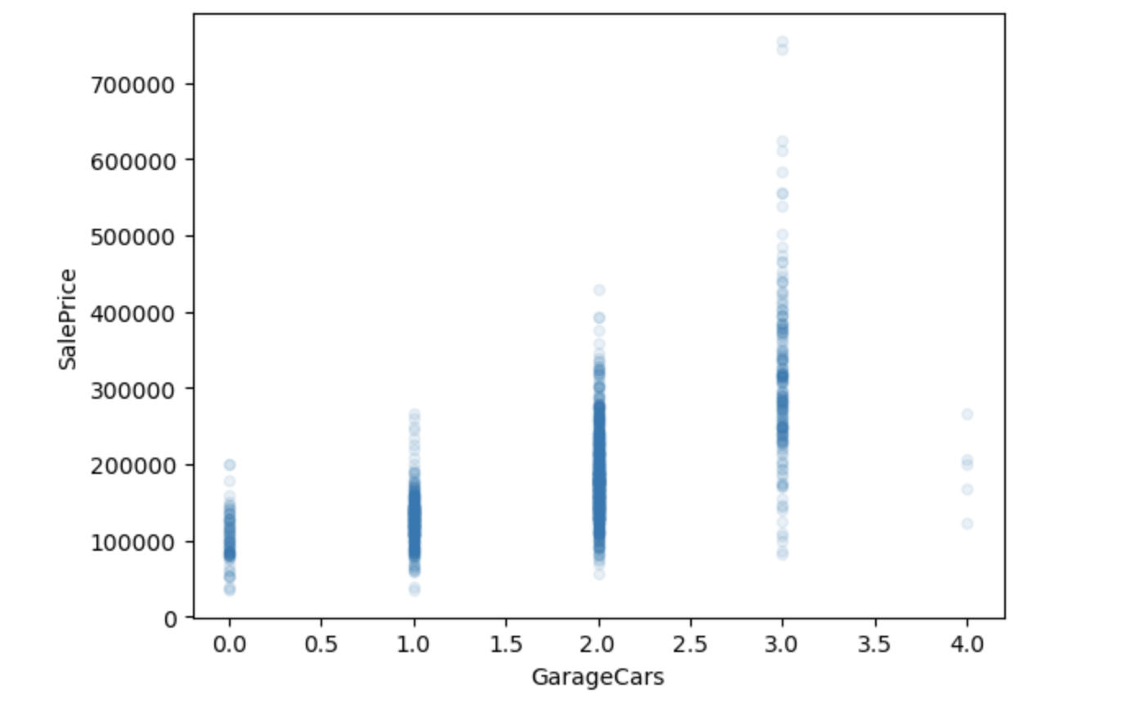
Sales Price/Garage

Slide 14
Selecting and Training a Model
We used supervised machine learning regression models to analyze the continuous variable in the dataset which was the Sales Price.
We started out with three options:
Decision Tree Regressor
Random Forest Regressor
Gradient Boosting Regressor

Slide 15
Scikit Learn’s Cross Validation
To make our decision, we evaluated our dataset using Scikit Learn’s Cross Validation Feature. This feature split our dataset in 10 subsets, trains, and evaluated each data subset 10 times. The advantages include:
Giving us an estimate of our model’s performance
Calculated the Standard derivation which lets us know how precise the estimate is.

Slide 16
Fine Tuning the Model
To fine-tune our model we needed to decide on the best hyperparameter to use.
To help with this, we utilized Scikit Learn’s GridSearch function.
Using GridSearch, we were not only able to determine the best hyperparameter but we were also able to determine the best estimator to pair the hyperparameter with.
With our model decided, we are successfully able to make predictions.

Slide 17
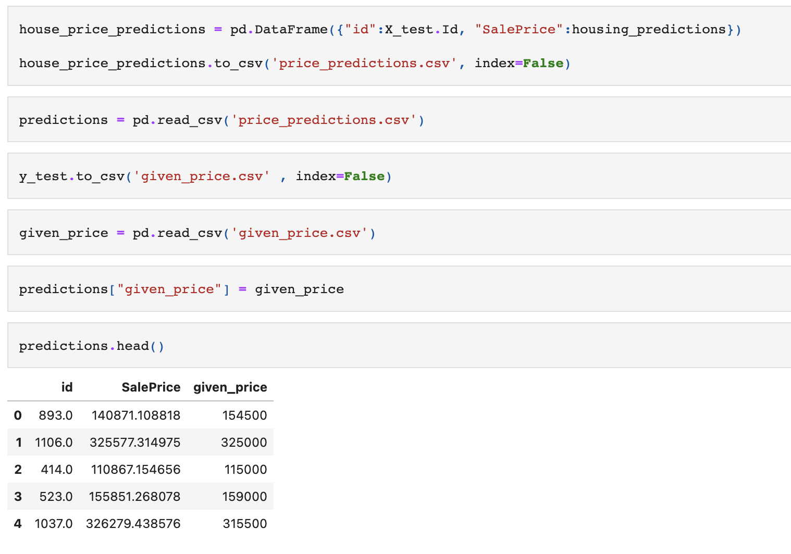
Results

Slide 18
Conclusion/Summary
Many features have an impact on the pricing of the home such as:
Built in garage
Greater living area included
Pool
Alley Feature

Slide 19
Next Steps
Our next steps would be to answer some other pressing questions.
Such as,
What are the top 5 most expensive neighborhoods?
What is the average selling price of different building types?

Slide 20
Conclusion
Thank you all for your time tonight.
Any Questions?

